Slide 1


ARVIONIQS
Governed intelligence
Authorised action
Company records and verified AI work
FULL PLATFORM OVERVIEW
ARVIONIQS / OCTOBER 2026
01
Notes:
Source: Angel-Investor-Overview-Memry-Verikeep.pdf, supplied by the user, dated 5 October 2026. Source-reported capabilities, not independently verified. Proposed ARVIONIQS naming. Existing ARVIONIQS visual assets are conceptual illustrations, not operational deployments.

Slide 2
WHY ARVIONIQS
The accountability gap
01
02
03
Company memory fragments
AI claims need evidence
Authority needs boundaries
Agreements sit in documents and inboxes. New information can obscure the accepted position.
An agent can say a task is complete without showing that the work or checks actually ran.
A suggestion should become an accepted fact or action only through the required rules and approval.
ARVIONIQS / OCTOBER 2026
02
Notes:
Source: Angel-Investor-Overview-Memry-Verikeep.pdf, supplied by the user, dated 5 October 2026. Source-reported capabilities, not independently verified. Proposed ARVIONIQS naming. Existing ARVIONIQS visual assets are conceptual illustrations, not operational deployments.

Slide 3

SYSTEM OVERVIEW
The ARVIONIQS proposition
A record the business can inspect
Connect sources to commitments, decisions and their history.
A check on what agents claim
Compare completion claims with recorded activity and code evidence.
People retain decision authority
Escalate conflicts and consequential decisions to authorised reviewers.
ARVIONIQS / OCTOBER 2026
03
Notes:
Source: Angel-Investor-Overview-Memry-Verikeep.pdf, supplied by the user, dated 5 October 2026. Source-reported capabilities, not independently verified. Proposed ARVIONIQS naming. Existing ARVIONIQS visual assets are conceptual illustrations, not operational deployments.

Slide 4
PROPOSED PRODUCT FAMILY
Two products under one brand
01
02
ARVIONIQS Record
ARVIONIQS Verify
A company workspace for evidence, obligations, conflicts and accountable approvals.
For operations, commercial and governance teams.
A local developer workspace for agent oversight and verification of delivery claims.
For teams building software with AI agents.
Shared foundation: CORE governed memory and the internal Build engine
ARVIONIQS / OCTOBER 2026
04
Notes:
Source: Angel-Investor-Overview-Memry-Verikeep.pdf, supplied by the user, dated 5 October 2026. Source-reported capabilities, not independently verified. Proposed ARVIONIQS naming. Existing ARVIONIQS visual assets are conceptual illustrations, not operational deployments.

Slide 5
ARCHITECTURE
The shared technology foundation
CORE
Governed memory, source provenance, fact status and decision history.
Build
Internal planning, plan review, execution checks and failure handling.
Intelligence, Guard, Connect and App
The existing ARVIONIQS module framework for interpretation, authority, approved sources and user experience.
ARVIONIQS / OCTOBER 2026
05
Notes:
Source: Angel-Investor-Overview-Memry-Verikeep.pdf, supplied by the user, dated 5 October 2026. Source-reported capabilities, not independently verified. Proposed ARVIONIQS naming. Existing ARVIONIQS visual assets are conceptual illustrations, not operational deployments.
Brand mapping: Memry to Record, Verikeep to Verify, Cairn to CORE, Sentinel to Build. CORE and Build are internal engines, not standalone customer products. The combined ARVIONIQS integration is proposed.

Slide 6

COMPANY EVIDENCE AND OBLIGATIONS
ARVIONIQS Record
The agreed position stays visible
Track who owes what, to whom, by when and under which terms.
Every fact has a source
Keep the supporting passage connected to the proposed fact.
Conflicts reach a person
Preserve both accounts when new information contradicts a locked fact.
ARVIONIQS / OCTOBER 2026
06
Notes:
Source: Angel-Investor-Overview-Memry-Verikeep.pdf, supplied by the user, dated 5 October 2026. Source-reported capabilities, not independently verified. Proposed ARVIONIQS naming. Existing ARVIONIQS visual assets are conceptual illustrations, not operational deployments.

Slide 7
RECORD WORKFLOW
How a document becomes an accepted record
01
02
03
Extract with evidence
Review the proposal
Preserve the decision
AI proposes facts and quotes the exact source passage. The document remains available for inspection.
A person approves, edits, declines or asks for clarification. Status distinguishes proposals from agreements.
Keep the accepted record and its history. Route later contradictions through review.
ARVIONIQS / OCTOBER 2026
07
Notes:
Source: Angel-Investor-Overview-Memry-Verikeep.pdf, supplied by the user, dated 5 October 2026. Source-reported capabilities, not independently verified. Proposed ARVIONIQS naming. Existing ARVIONIQS visual assets are conceptual illustrations, not operational deployments.

Slide 8
CORE CONTROLS
Authority lives in the record
Fact status
Guessed, proposed, agreed and locked remain distinct states.
Rules before changes
The AI proposes updates. The engine checks whether the change is permitted.
History remains available
Superseding records link to earlier versions, supporting an “as of” view.
ARVIONIQS / OCTOBER 2026
08
Notes:
Source: Angel-Investor-Overview-Memry-Verikeep.pdf, supplied by the user, dated 5 October 2026. Source-reported capabilities, not independently verified. Proposed ARVIONIQS naming. Existing ARVIONIQS visual assets are conceptual illustrations, not operational deployments.

Slide 9
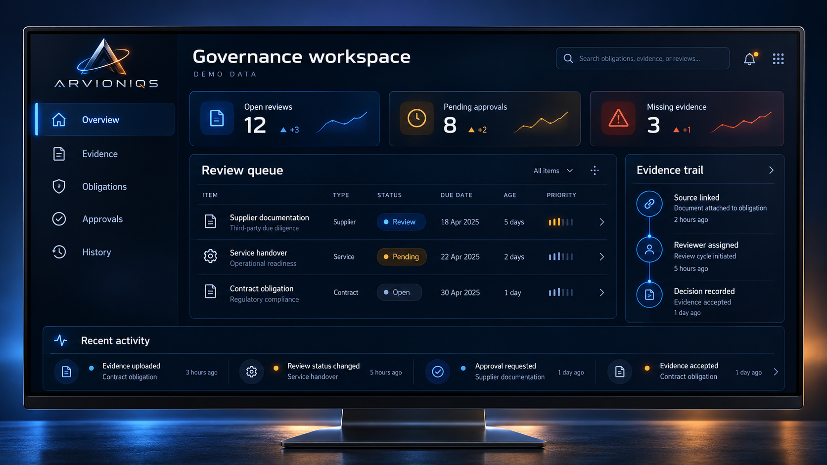
RECORD INTERFACE CONCEPT
The decision workspace
Concept interface with demonstration data. Final product experience and deployment scope require validation.
ARVIONIQS / OCTOBER 2026
09
Notes:
Source: Angel-Investor-Overview-Memry-Verikeep.pdf, supplied by the user, dated 5 October 2026. Source-reported capabilities, not independently verified. Proposed ARVIONIQS naming. Existing ARVIONIQS visual assets are conceptual illustrations, not operational deployments.

Slide 10
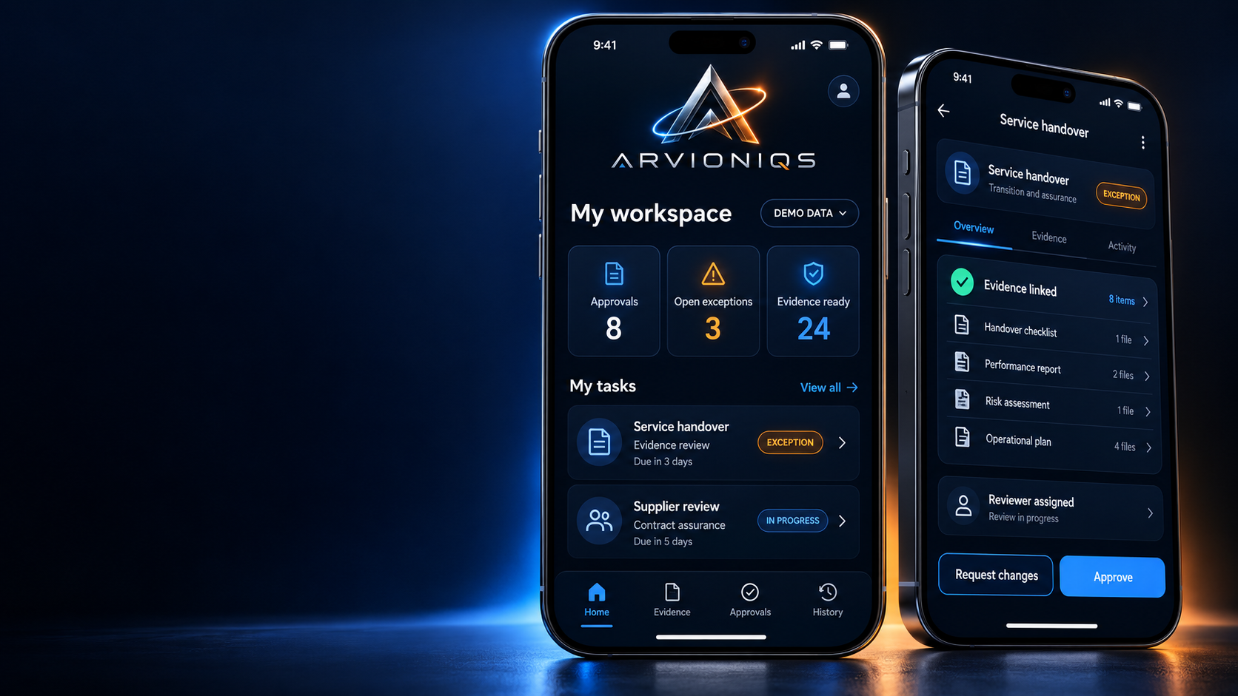
APP CONCEPT
Mobile approvals
The right queue
See the reviews that need your attention.
The evidence behind it
Open the source before accepting the proposed decision.
A named decision
Approve, return or escalate within your authority.
iPhone 18 Pro Max design concept. Not a shipping app.
ARVIONIQS / OCTOBER 2026
10
Notes:
Source: Angel-Investor-Overview-Memry-Verikeep.pdf, supplied by the user, dated 5 October 2026. Source-reported capabilities, not independently verified. Proposed ARVIONIQS naming. Existing ARVIONIQS visual assets are conceptual illustrations, not operational deployments.

Slide 11
AI AGENT OVERSIGHT
ARVIONIQS Verify
01
02
03
Fleet visibility
Completion checks
Project continuity
See agent activity, questions and alerts in one place. Surface agents that appear stuck or looping.
Compare claims such as “tests pass”, “committed” and “pushed” with transcripts and code history.
Keep or reject proposed project memory. Start the next session with accepted context.
Reported tested core: Claude Code on Linux. Other vendor support is on the roadmap.
ARVIONIQS / OCTOBER 2026
11
Notes:
Source: Angel-Investor-Overview-Memry-Verikeep.pdf, supplied by the user, dated 5 October 2026. Source-reported capabilities, not independently verified. Proposed ARVIONIQS naming. Existing ARVIONIQS visual assets are conceptual illustrations, not operational deployments.

Slide 12
VERIFY EXAMPLE
A claim of completion needs a receipt
Agent claim: “Tests pass and the change is pushed”
The statement alone does not establish completion.
Evidence review
Compare the transcript with test activity and the repository history.
A visible verdict
Show uncertainty when evidence is missing. Source describes advisory amber verdicts while checker accuracy is assessed.
ARVIONIQS / OCTOBER 2026
12
Notes:
Source: Angel-Investor-Overview-Memry-Verikeep.pdf, supplied by the user, dated 5 October 2026. Source-reported capabilities, not independently verified. Proposed ARVIONIQS naming. Existing ARVIONIQS visual assets are conceptual illustrations, not operational deployments.

Slide 13
ENGINEERING DISCIPLINE
The development method
01
02
03
Proof on every change
Independent review
Continuity and recovery
Record the checks that ran and their results. Combine automated gates with review of the evidence.
Challenge the design before implementation. Simplify a design when repeated review exposes weaknesses.
Keep decisions and session handovers. Use checkpoints and rollback when execution fails.
Passing tests alone does not prove security or correctness.
ARVIONIQS / OCTOBER 2026
13
Notes:
Source: Angel-Investor-Overview-Memry-Verikeep.pdf, supplied by the user, dated 5 October 2026. Source-reported capabilities, not independently verified. Proposed ARVIONIQS naming. Existing ARVIONIQS visual assets are conceptual illustrations, not operational deployments.

Slide 14
DIFFERENTIATION
The combined advantage
Memory with authority
Persistent context includes who can accept or change a fact.
Verification outside the agent
Delivery claims face checks against evidence beyond the agent’s own assertion.
A reusable foundation
Company workflows and developer tools can share governed memory while serving different users.
ARVIONIQS / OCTOBER 2026
14
Notes:
Source: Angel-Investor-Overview-Memry-Verikeep.pdf, supplied by the user, dated 5 October 2026. Source-reported capabilities, not independently verified. Proposed ARVIONIQS naming. Existing ARVIONIQS visual assets are conceptual illustrations, not operational deployments.

Slide 15

ILLUSTRATIVE USE CASES
Defence industry applications
Procurement and contract review
Connect requirements, supplier evidence and accepted terms.
Maintenance documentation
Carry open issues and supporting documents into the next handover.
Software delivery oversight
Review AI coding agents’ completion claims while people retain release authority.
Administrative and engineering support concepts. No defence accreditation claimed.
ARVIONIQS / OCTOBER 2026
15
Notes:
Source: Angel-Investor-Overview-Memry-Verikeep.pdf, supplied by the user, dated 5 October 2026. Source-reported capabilities, not independently verified. Proposed ARVIONIQS naming. Existing ARVIONIQS visual assets are conceptual illustrations, not operational deployments.

Slide 16
DEFENCE EXAMPLE
A maintenance handover with an open exception
01
02
03
The requirement
The review
The acceptance
The service pack needs a supporting document. Record links that requirement to the source and owner.
Missing evidence remains visible. A qualified reviewer requests clarification and reviews the response.
An authorised person records the outcome. The next team can inspect the evidence and sign-off history.
ARVIONIQS / OCTOBER 2026
16
Notes:
Source: Angel-Investor-Overview-Memry-Verikeep.pdf, supplied by the user, dated 5 October 2026. Source-reported capabilities, not independently verified. Proposed ARVIONIQS naming. Existing ARVIONIQS visual assets are conceptual illustrations, not operational deployments.

Slide 17
DEFENCE ENGINEERING EXAMPLE
Software changes behind the handover tool
Record carries the accepted requirement
The engineering team can refer to the agreed workflow and evidence rules.
Verify checks agent delivery claims
If coding agents change the tool, compare claimed tests and commits with recorded evidence.
People approve release
Quality, security and deployment checks remain necessary. Agent verification does not certify airworthiness.
ARVIONIQS / OCTOBER 2026
17
Notes:
Source: Angel-Investor-Overview-Memry-Verikeep.pdf, supplied by the user, dated 5 October 2026. Source-reported capabilities, not independently verified. Proposed ARVIONIQS naming. Existing ARVIONIQS visual assets are conceptual illustrations, not operational deployments.

Slide 18
CUSTOMER ASSURANCE
Security and deployment boundaries
Define the permitted data
Agree hosting, retention, access boundaries and approved model connections.
Validate the whole environment
A local verification tool does not make connected coding agents or model services offline.
Complete the release gates
Security hardening and company data isolation remain launch work in the supplied overview.
Begin defence pilots with synthetic or approved non-classified data.
ARVIONIQS / OCTOBER 2026
18
Notes:
Source: Angel-Investor-Overview-Memry-Verikeep.pdf, supplied by the user, dated 5 October 2026. Source-reported capabilities, not independently verified. Proposed ARVIONIQS naming. Existing ARVIONIQS visual assets are conceptual illustrations, not operational deployments.

Slide 19
READINESS AS OF 5 OCTOBER 2026
What the source reports today
Record: working demonstration release
Invite-only. Commercial launch still requires billing, erasure support, public-surface hardening, isolation completion and model endpoint choice.
Verify: tested core
Claude Code on Linux. Handovers and installation work await completion or merge. Sign-up and billing remain launch work.
Build: oversight running, build work paused
The build pipeline has known acceptance failures. A tested CORE link exists, without measured learning benefit yet.
ARVIONIQS / OCTOBER 2026
19
Notes:
Source: Angel-Investor-Overview-Memry-Verikeep.pdf, supplied by the user, dated 5 October 2026. Source-reported capabilities, not independently verified. Proposed ARVIONIQS naming. Existing ARVIONIQS visual assets are conceptual illustrations, not operational deployments.
Source pp. 7, 10–11 and 16–17. These are source-reported statuses, not independent certification. Branding does not establish IP transfer or integration.

Slide 20
DESIGNED CAPABILITIES AND FUTURE DIRECTIONS
The roadmap
01
02
03
Record operator
Verify expansion
Broader adoption
Proactive draft follow-ups and documents for approval. Expanded noticing and confidential team areas.
Wider agent support, checked handovers and planning. Proposed spec-to-software orchestration.
Team rulebooks, signed decision records and additional workflows built on the shared engines.
Roadmap, not current availability. Sequence and release dates require engineering validation.
ARVIONIQS / OCTOBER 2026
20
Notes:
Source: Angel-Investor-Overview-Memry-Verikeep.pdf, supplied by the user, dated 5 October 2026. Source-reported capabilities, not independently verified. Proposed ARVIONIQS naming. Existing ARVIONIQS visual assets are conceptual illustrations, not operational deployments.

Slide 21
PROPOSED EVALUATION
A focused 90-day pilot
01
02
03
Days 1–15
Scope and baseline
Days 16–60
Configure and test
Days 61–90
Decision
Choose one workflow, an accountable owner and permitted data. Measure the current process.
Import approved records. Review conflicts and access boundaries. Test with representative tasks.
Compare evidence retrieval time, approval traceability and unresolved critical findings with agreed criteria.
Acceptance criteria are agreed pilot goals, not achieved results.
ARVIONIQS / OCTOBER 2026
21
Notes:
Source: Angel-Investor-Overview-Memry-Verikeep.pdf, supplied by the user, dated 5 October 2026. Source-reported capabilities, not independently verified. Proposed ARVIONIQS naming. Existing ARVIONIQS visual assets are conceptual illustrations, not operational deployments.

Slide 22
PROPOSED MODEL
Commercial adoption
01
02
03
Record
Verify
Expansion
A bounded paid pilot, followed by an annual agreement reflecting users, workflow and deployment scope.
A developer offering with a potential team tier. Packaging and billing require launch completion.
Add workflows after proving value. Confirm integrations and access for each organisation.
Pricing, customer traction and revenue are not established by the supplied overview.
ARVIONIQS / OCTOBER 2026
22
Notes:
Source: Angel-Investor-Overview-Memry-Verikeep.pdf, supplied by the user, dated 5 October 2026. Source-reported capabilities, not independently verified. Proposed ARVIONIQS naming. Existing ARVIONIQS visual assets are conceptual illustrations, not operational deployments.

Slide 23
IMPLEMENTATION PRIORITIES
The ARVIONIQS path forward
Confirm the rights and product integration
The source says the creator holds the technology. Formalise the intended ARVIONIQS scope before making ownership claims.
Complete the commercial release work
Close product-specific security and operational gaps, then validate the combined customer experience.
Demonstrate one valuable workflow
Use evidence from the pilot to support wider adoption and the next product release.
ARVIONIQS / OCTOBER 2026
23
Notes:
Source: Angel-Investor-Overview-Memry-Verikeep.pdf, supplied by the user, dated 5 October 2026. Source-reported capabilities, not independently verified. Proposed ARVIONIQS naming. Existing ARVIONIQS visual assets are conceptual illustrations, not operational deployments.

Slide 24
ARVIONIQS
Governed intelligence
Authorised action
A stronger record.
Evidence behind the next decision.
arvioniqs.com
ARVIONIQS / OCTOBER 2026
24
Notes:
Source: Angel-Investor-Overview-Memry-Verikeep.pdf, supplied by the user, dated 5 October 2026. Source-reported capabilities, not independently verified. Proposed ARVIONIQS naming. Existing ARVIONIQS visual assets are conceptual illustrations, not operational deployments.

